Slide 1
Mol-Sim Lecture #4: Forcefields/Classical MD
Chris Nyambura
Graduate Student, Nance Research Lab/Pfaendtner Research Lab
Department of Chemical Engineering
PIs: Jim Pfaendtner/Elizabeth Nance
January 29, 2020
Notes:
…
…
…
Lab Meeting
Date
For any external to lab meeting presentation, you should put
Author list with all contributing authors, your name bolded (since you are presenting the work), and my name last
Department
…
…
…
Name of presentation (i.e. BMES Annual Meeting)
Date

Slide 2
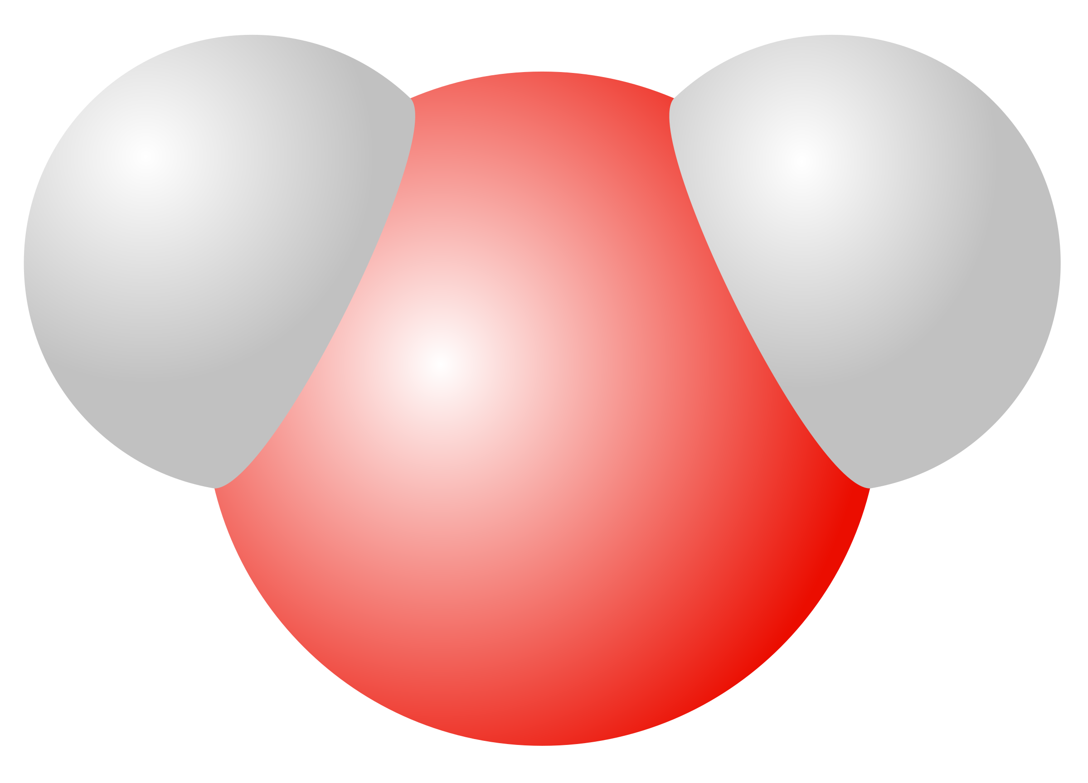
What is Classical Molecular Dynamics?
Computational technique to model the time evolution of the motion of a classical many-body system, that allow for the calculation of equilibrium and transport properties
Main Assumptions
Each particle has a Van der Waals (VdW) radius
No bonds are broken or formed
Each particle has a static point charge
Each particle has constant point mass
Frenkel and Smit, Understanding Molecular Simulation, Vol 2 (2nd edition)

Slide 3
What is Classical Molecular Dynamics?
Computational technique to model the time evolution of the motion of a classical many-body system, that allow for the calculation of equilibrium and transport properties
System Characteristics
Atomic descriptors:
$\vec{r}$ , $\vec{p}$
3D Coordinates $( \vec{r_{i}}\left(x,y,z\right) )$
Momenta $( \vec{p_{i}}= m_{i}\frac{d\vec{r_{i}}}{dt}= m_{i}v_{i}$ )
Equations of motion:
$$−\frac{∂V}{∂r_{i}}=F_{i}= m_{i}a_{i}$$
$$−\frac{1}{m_{i}}\frac{∂V}{∂r_{i}}=a_{i}$$
MD needs a differentiable pair potential to ensure realistic atomic dynamics
Frenkel and Smit, Understanding Molecular Simulation, Vol 2 (2nd edition)
Notes:
Potential energy function

Slide 4
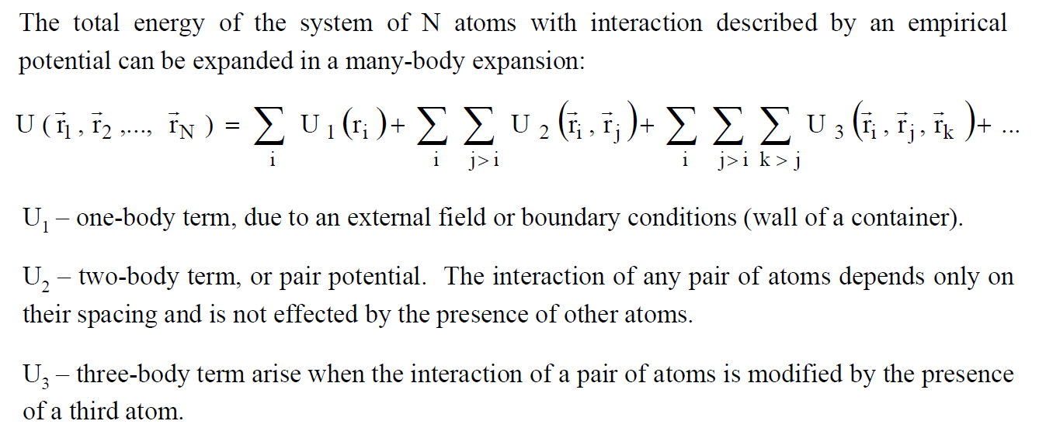
What is Classical Molecular Dynamics?
[1] Frenkel and Smit, Understanding Molecular Simulation, Vol 2 (2nd edition)
[2] http://people.virginia.edu/~lz2n/mse627/notes/Potentials.pdf
Notes:
Hidden Slide

Slide 5
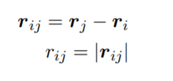
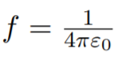
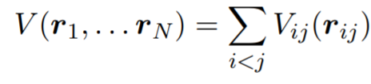
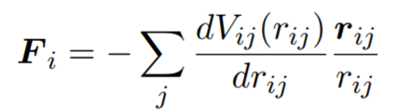
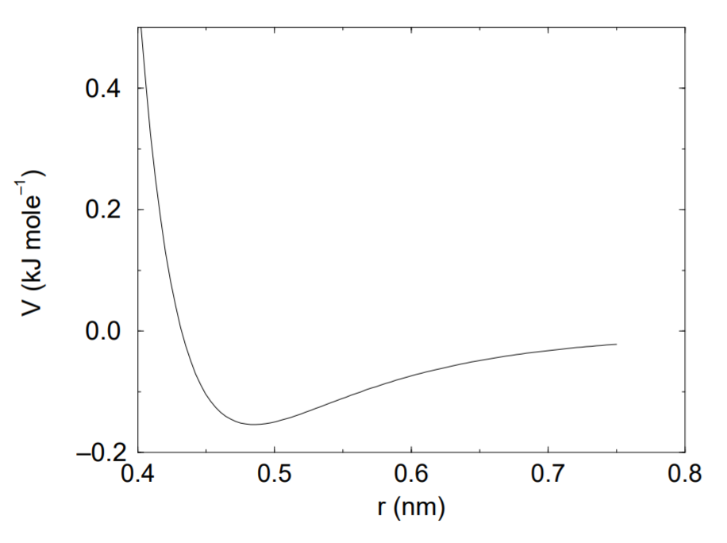
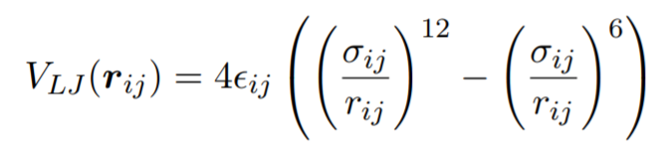
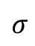
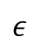

Non-bonded force calculation
$$F_{i}=F_{bonded}+ F_{nonbonded}(r_{ij})$$
Only 2-body interactions are considered
Lennard-Jones Potential (Van der Waals (VdW) interactions)
$$σ$$
$$ε$$
Frenkel and Smit, Understanding Molecular Simulation, Vol 2 (2nd edition)
Notes:
Potentials only depends on scalar distance
Short range interactions are calculated for atoms within the cutoff. Long range interactions are calculated by the particle mesh ewald summation
electric conversion factor: it relates mechanical and electrical quantities

Slide 6
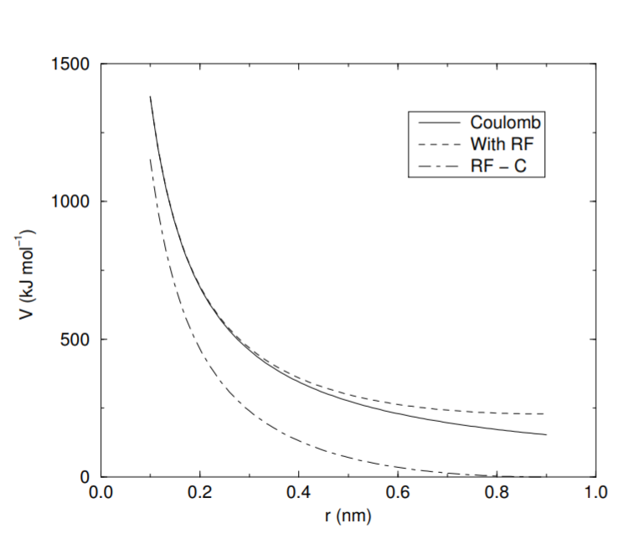
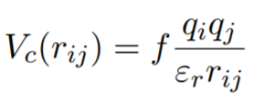

Non-bonded force calculation
$$F_{i}=F_{bonded}+ F_{nonbonded}(r_{ij})$$
Only 2-body interactions are considered
Lennard-Jones Potential (Van der Waals (VdW) interactions)
Charge potential (Coulombic interactions)
Frenkel and Smit, Understanding Molecular Simulation, Vol 2 (2nd edition)
Notes:
Potentials only depends on scalar distance
Non pair-additive interactions, the most important example of which is interaction through atomic polarizability, are represented by effective pair potentials.
Only average non pairadditive contributions are incorporated

Slide 7
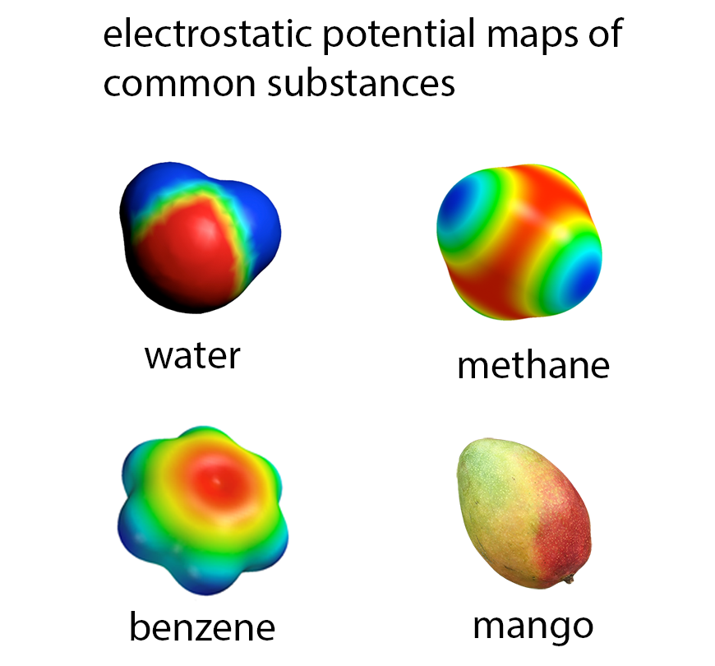
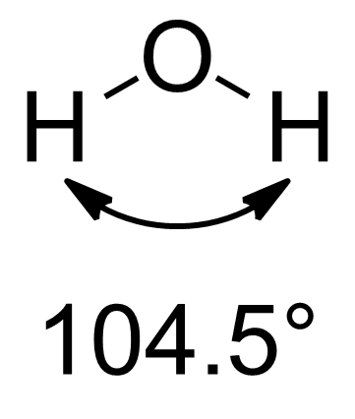
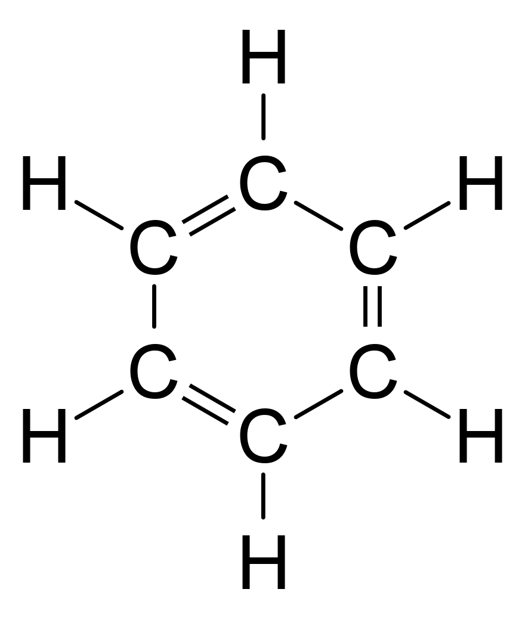
Charge Parametrization
$$+q$$
$$+q$$
$$−q$$
1) Calculate electrostatic potential at each atomic position
$$+q$$
2) Calculate charges, ensuring static charges equal charge of molecule
$$−q$$
$$−q$$
$$+q$$
$$+q$$
$$−q$$
$$−q$$
$$−q$$
$$−q$$
$$+q$$
$$+q$$
$$+q$$
[2] http://people.virginia.edu/~lz2n/mse627/notes/Potentials.pdf
Notes:
Hidden Slide

Slide 8
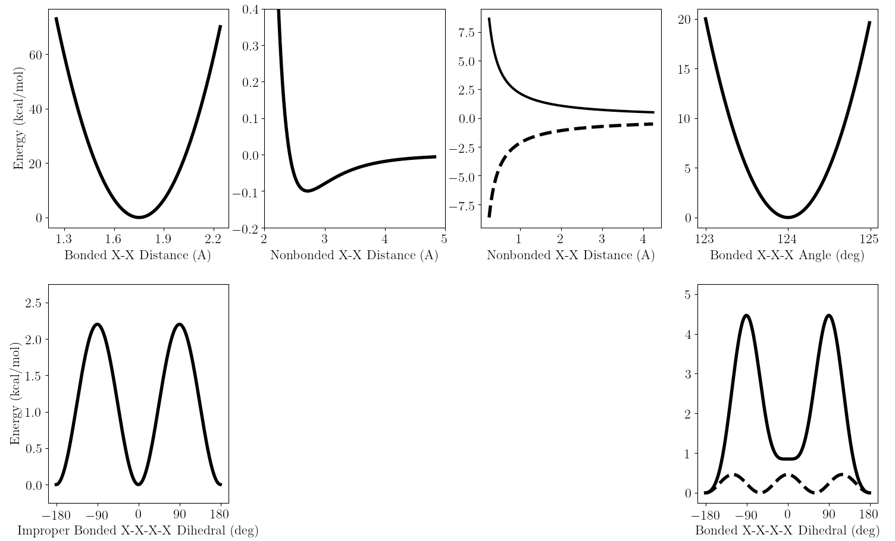

Non-bonded force calculation
Harmonic Bond
L-J Dispersion
Coulombic
Harmonic Angle
Out-of-Plane Bend
Torsion
Frenkel and Smit, Understanding Molecular Simulation, Vol 2 (2nd edition)
http://cbio.bmt.tue.nl/pumma/index.php/Theory/Potentials

Slide 9
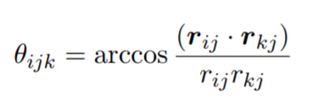
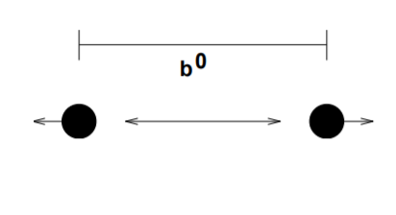
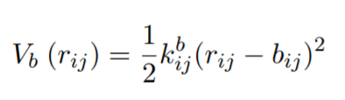
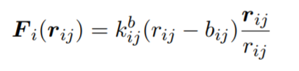
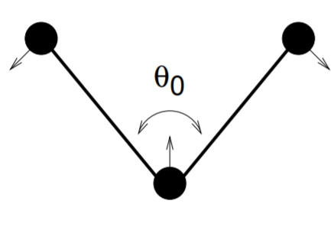
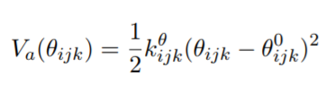
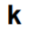
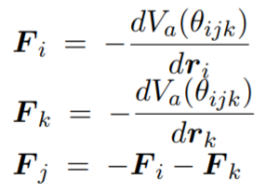
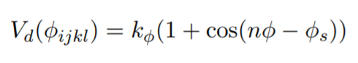
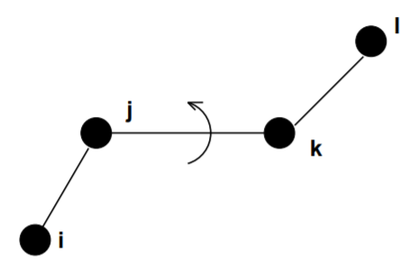
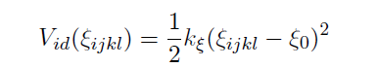
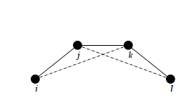

Bonded force calculation
$$F_{i}=F_{bonded}+ F_{nonbonded}(r_{ij})$$
bond stretching
bond-angle vibration
torsional vibration
Harmonic/Periodic Potentials
Frenkel and Smit, Understanding Molecular Simulation, Vol 2 (2nd edition)
Notes:
The classical oscillator absorbs too much energy (kT), while the high frequency quantum oscillator is in its ground state at the zero-point energy level of 1/2 hν.
We can treat the bonds (and bond angles) as constraints in the equations of motion. The rationale behind this is that a quantum oscillator in its ground state resembles a constrained bond more closely than a classical oscillator

Slide 10
Bonded force calculation
Harmonic Bond
L-J Dispersion
Coulombic
Harmonic Angle
Out-of-Plane Bend
Torsion
Ensemble of microstates to sample
Frenkel and Smit, Understanding Molecular Simulation, Vol 2 (2nd edition)
http://cbio.bmt.tue.nl/pumma/index.php/Theory/Potentials

Slide 11
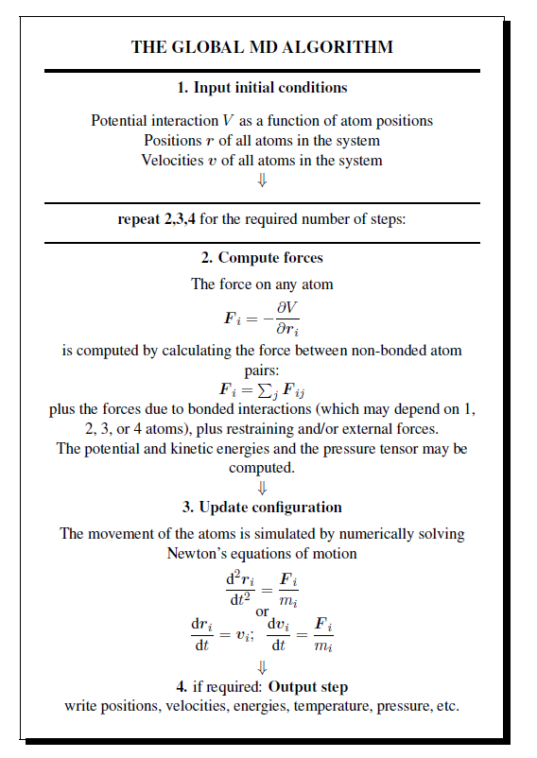
MD Requirements
GROMACS 2016.3 manual. http://manual.gromacs.org/documentation/2016.3/

Slide 12
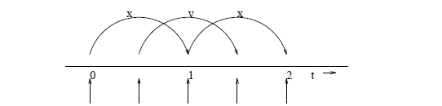
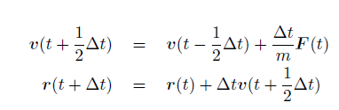
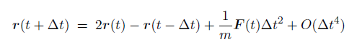
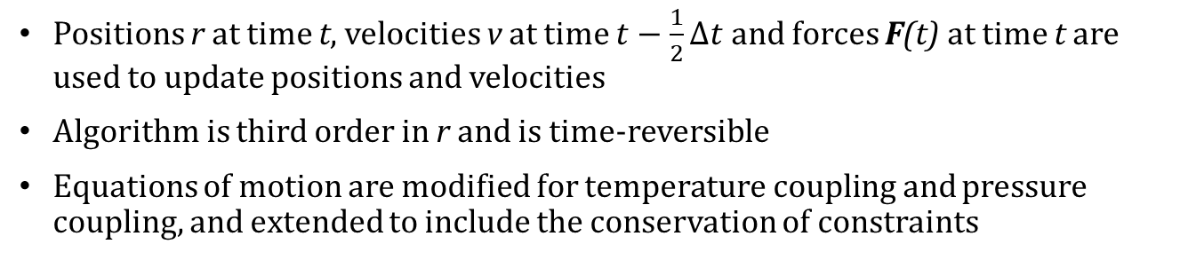
Timestep Integration
Leap-frog integrator (Default for GROMACS)
Positions r at time t, velocities v at time $t−\frac{1}{2}∆t$ and forces F(t) at time t are used to update positions and velocities
Algorithm is third order in r and is time-reversible
Equations of motion are modified for temperature coupling and pressure coupling, and extended to include the conservation of constraints
GROMACS 2016.3 manual. http://manual.gromacs.org/documentation/2016.3/

Slide 13
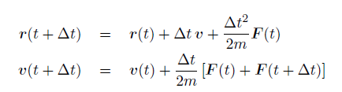
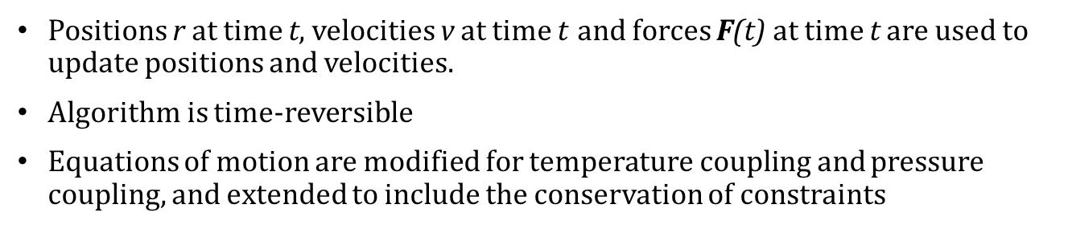
Timestep Integration
Velocity Verlet integrator (Mainly used for NPT simulations)
Positions r at time t, velocities v at time $t$ and forces F(t) at time t are used to update positions and velocities.
Algorithm is time-reversible
Equations of motion are modified for temperature coupling and pressure coupling, and extended to include the conservation of constraints
GROMACS 2016.3 manual. http://manual.gromacs.org/documentation/2016.3/
Notes:
Velocity from previous timestep not required

Slide 14
Timestep Integration differences
Leap-frog integrator (Mainly used for NVT simualtions)
Velocity Verlet integrator (Mainly used for NPT simulations)
With NO temp. or pressure coupling (NVE ensemble) AND corresponding starting points, both algorithms will generate identical trajectories
Trajectory and potential energies are identical using both algorithms but kinetic energy and temperature will NOT be same for NVT, NPT ensembles
Velocity Verlet requires twice as many communication calls but integration time is around the same as leap-frog
Velocity Verlet is needed for rigorous pressure control for NPT ensembles, leap-frog cannot be used accurate NPT simulations
Leap-frog integrator is preferred for NVT simulations in GROMACS
GROMACS 2016.3 manual. http://manual.gromacs.org/documentation/2016.3/

Slide 15
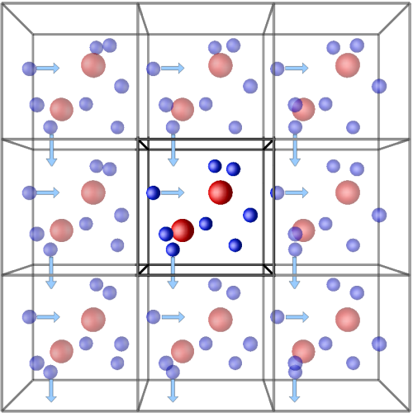
Minimizing Edge Effects
Periodic Boundaries:
Minimum Image Convention
The nearest image of each particle is considered for short-range non-bonded interaction terms.
Avoid real phase boundaries and capture bulk behavior of system
Long range electrostatic interactions:
Particle Mesh Ewald Summations
Frenkel and Smit, Understanding Molecular Simulation, Vol 2 (2nd edition)

Slide 16
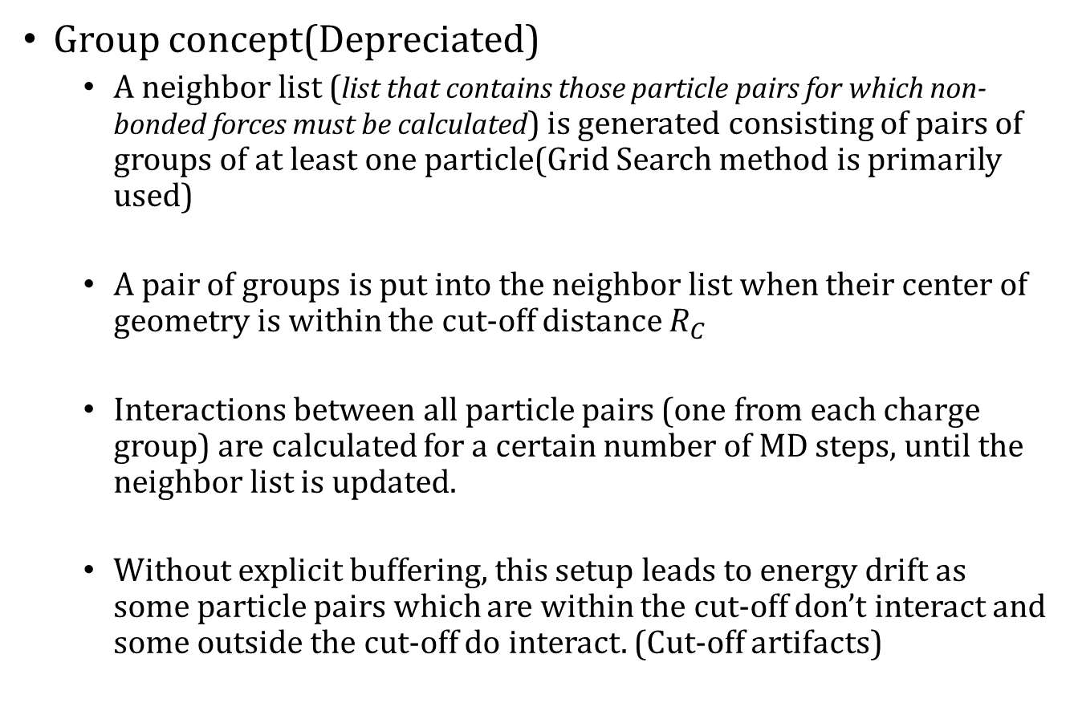
Cut-off Schemes
Group concept(Depreciated)
A neighbor list (list that contains those particle pairs for which non-bonded forces must be calculated) is generated consisting of pairs of groups of at least one particle(Grid Search method is primarily used)
A pair of groups is put into the neighbor list when their center of geometry is within the cut-off distance $R_{C}$
Interactions between all particle pairs (one from each charge group) are calculated for a certain number of MD steps, until the neighbor list is updated.
Without explicit buffering, this setup leads to energy drift as some particle pairs which are within the cut-off don’t interact and some outside the cut-off do interact. (Cut-off artifacts)
GROMACS 2016.3 manual. http://manual.gromacs.org/documentation/2016.3/
Notes:
To make the neighbor list, all particles that are close (i.e. within the neighbor list cut-off) to a given
particle must be found.
This searching, usually called neighbor search (NS) or pair search, involves
periodic boundary conditions and determining the image (see sec. 3.2).
The search algorithm is O(N), although a simpler O(N2) algorithm is still available under some conditions.

Slide 17
Cut-off Schemes
Verlet buffer (Primary Default for GROMACS)
Uses dynamic clusters of particles that are defined spatially and consist of 4 or 8 particles
At neighbor search steps, a pair list is created with a Verlet buffer by default (the pair-list cut-off is larger than the interaction cut-off)
Interactions are only computed when a particle pair is within the cut-off distance, at that particular time step
Verlet cut-off scheme is implemented in a very efficient fashion based on clusters of particles
Non-bonded forces are switched off exactly to zero at some distance smaller than the neighbor list cut-off (Avoid cut-off artifacts)
GROMACS 2016.3 manual. http://manual.gromacs.org/documentation/2016.3/
Notes:
The non-bonded force calculation kernel can calculate many particle-pair interactions at once, which maps nicely to SIMD or SIMT units on modern hardware, which can perform multiple floating operations at once.

Slide 18
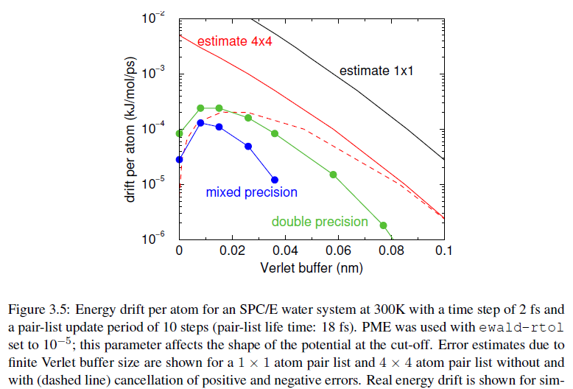
Cut-off Schemes
Verlet buffer (Primary Default for GROMACS)
GROMACS 2016.3 manual. http://manual.gromacs.org/documentation/2016.3/

Slide 19
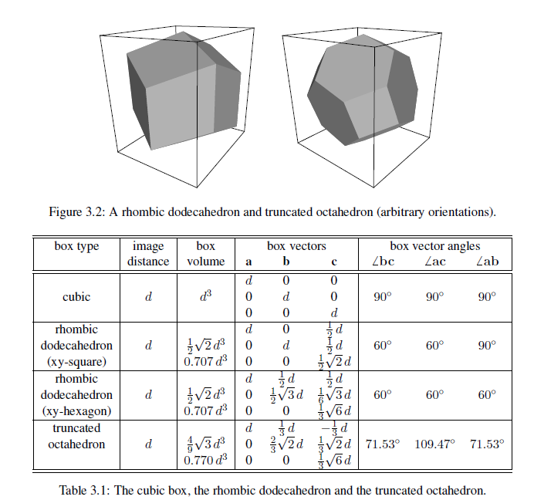
Minimizing Edge Effects
GROMACS 2016.3 manual. http://manual.gromacs.org/documentation/2016.3/

Slide 20
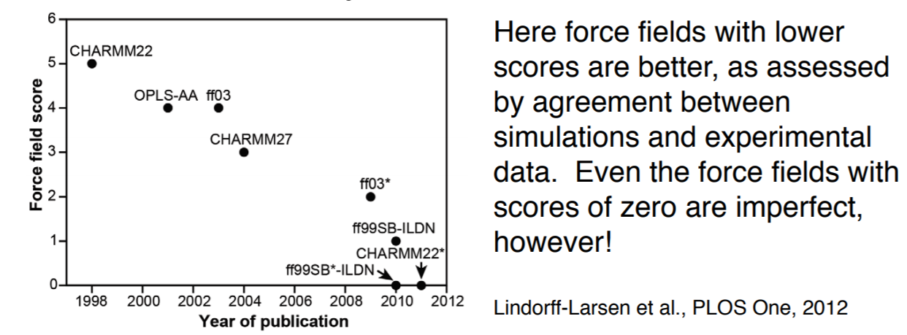
Forcefields
Still approximations for atomic motion
Need a priori knowledge of experimental phenomena that you want to probe
https://web.stanford.edu/class/cs279/lectures/lecture4.pdf

Slide 21
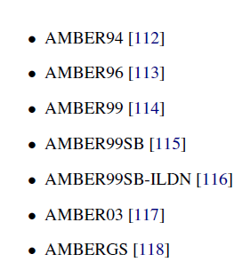
Forcefields
GROMOS-96
http://comp-bio.anu.edu.au/huber/papers/gromos96.pdf
AMBER
CHARMM
CHARMM22 (Lipids/Proteins)
CHARMM27 (Nucleic Acids)
OPLS-AA

Slide 22
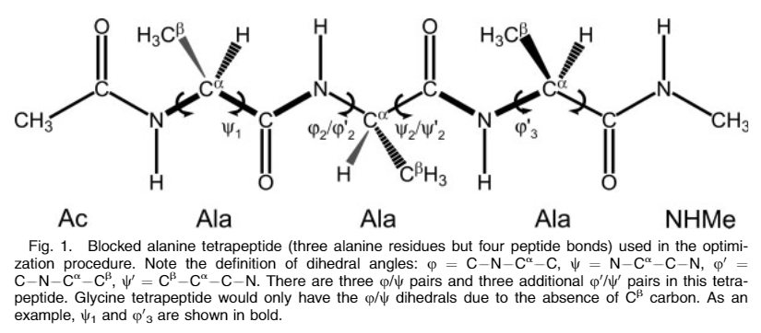
Forcefields
GROMOS-96
http://comp-bio.anu.edu.au/huber/papers/gromos96.pdf
AMBER
[1] Hornak, V., Abel, R., Okur, A., Strockbine, B., Roitberg, A., Simmerling, C. Comparison of Multiple Amber Force Fields and Development of Improved Protein Backbone Parameters. PROTEINS: Struct. Funct. Gen. 65:712–725, 2006.
Notes:
For Glycine, replace the methyl groups with hydrogens

Slide 23
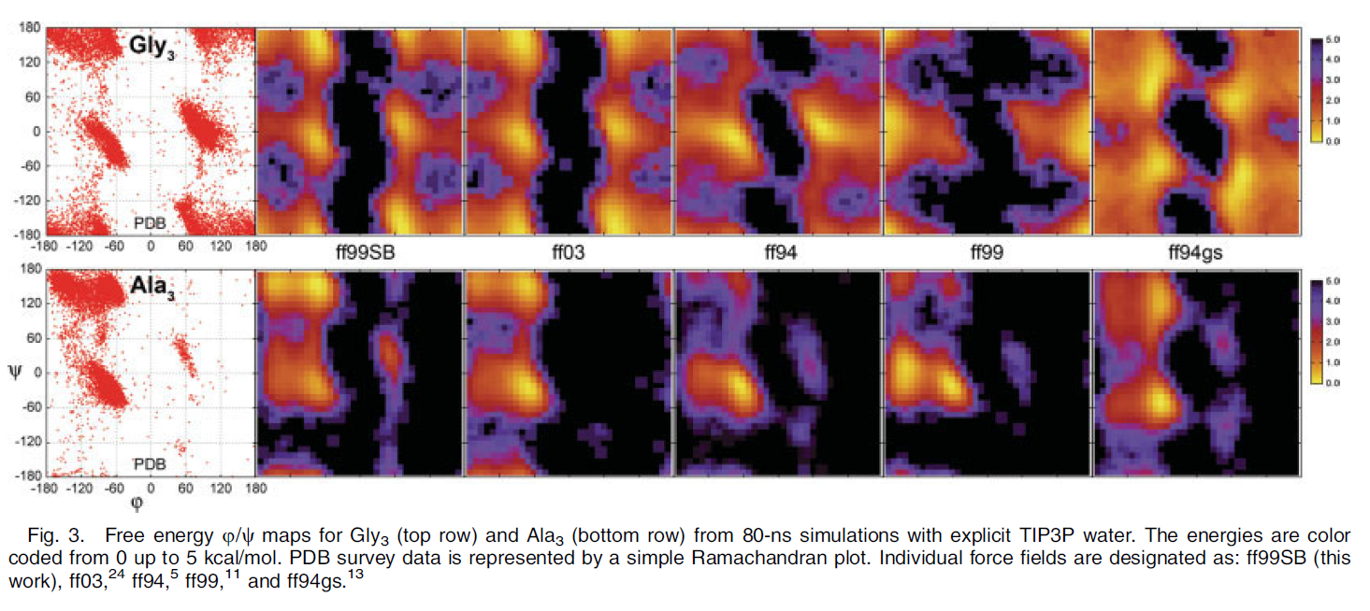
Forcefields
GROMOS-96
http://comp-bio.anu.edu.au/huber/papers/gromos96.pdf
AMBER
[1] Hornak, V., Abel, R., Okur, A., Strockbine, B., Roitberg, A., Simmerling, C. Comparison of Multiple Amber Force Fields and Development of Improved Protein Backbone Parameters. PROTEINS: Struct. Funct. Gen. 65:712–725, 2006.

Slide 24
Forcefields
GROMOS-96
http://comp-bio.anu.edu.au/huber/papers/gromos96.pdf
AMBER
CHARMM
CHARMM22 (Lipids/Proteins)
CHARMM27 (Nucleic Acids)
OPLS-AA

Slide 25
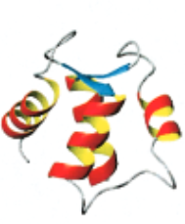
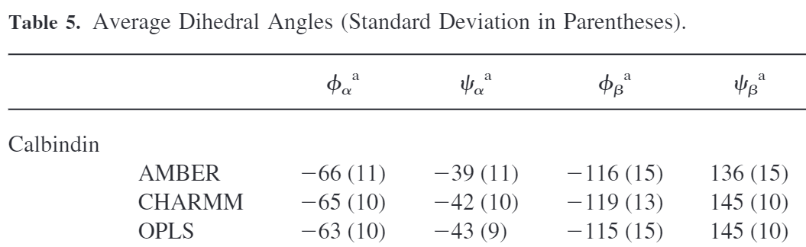
Forcefields
CHARMM
CHARMM22 (Lipids/Proteins)
CHARMM27 (Nucleic Acids)
Calbindin
[1] Price, D.J., Brooks, C.L., 2002. Modern protein force fields behave comparably in molecular dynamics simulations. J. Comput. Chem. 23, 1045–1057.

Slide 26
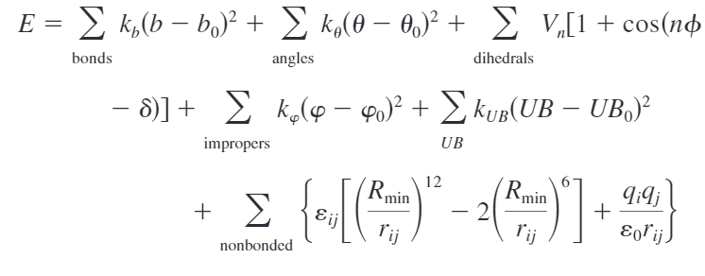
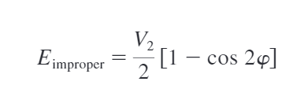
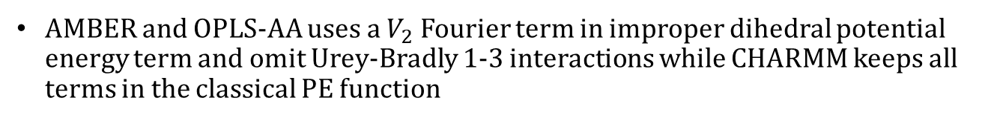
Forcefield differences
AMBER
CHARMM
OPLS-AA
Classical Potential Energy Function:
AMBER and OPLS-AA uses a $V_{2}$ Fourier term in improper dihedral potential energy term and omit Urey-Bradly 1-3 interactions while CHARMM keeps all terms in the classical PE function
[1] Price, D.J., Brooks, C.L., 2002. Modern protein force fields behave comparably in molecular dynamics simulations. J. Comput. Chem. 23, 1045–1057.

Slide 27
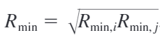
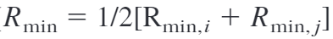


Forcefield differences
AMBER
CHARMM
OPLS-AA
Classical Potential Energy Function:
AMBER and OPLS-AA uses a $V_{2}$ Fourier term in improper dihedral potential energy term and omit Urey-Bradly 1-3 interactions while CHARMM keeps all terms in the classical PE function
OPLS uses a geometric combining rule to derive $R_{min}$ while AMBER and CHARMM combines $R_{min}$ arithmetically.
[1] Price, D.J., Brooks, C.L., 2002. Modern protein force fields behave comparably in molecular dynamics simulations. J. Comput. Chem. 23, 1045–1057.

Slide 28

Forcefield differences
AMBER
CHARMM
OPLS-AA
Classical Potential Energy Function:
AMBER and OPLS-AA uses a $V_{2}$ Fourier term in improper dihedral potential energy term and omit Urey-Bradly 1-3 interactions while CHARMM keeps all terms in the classical PE function
OPLS uses a geometric combining rule to derive $R_{min}$ while AMBER and CHARMM combines $R_{min}$ arithmetically.
Partial charges and Lennard–Jones parameters in OPLS are assigned empirically from iterative pure liquid and dilute solution simulations aimed at reproducing bulk condensed-phase properties
[1] Price, D.J., Brooks, C.L., 2002. Modern protein force fields behave comparably in molecular dynamics simulations. J. Comput. Chem. 23, 1045–1057.

Slide 29

Forcefield differences
AMBER
CHARMM
OPLS-AA
AMBER and OPLS-AA uses a $V_{2}$ Fourier term in improper dihedral potential energy term and omit Urey-Bradly 1-3 interactions while CHARMM keeps all terms in the classical PE function
OPLS uses a geometric combining rule to derive $R_{min}$ while AMBER and CHARMM combines $R_{min}$ arithmetically.
Partial charges and Lennard–Jones parameters in OPLS-AA are assigned empirically from iterative pure liquid and dilute solution simulations aimed at reproducing bulk condensed-phase properties
The AMBER uses partial charges derived from restrained electrostatic potential (RESP) fits to ab initio charge distributions obtained at the HF/6-31G* theory level
CHARMM parameters is largely fit to scaled ab initio interaction energies, also at the HF/6-31G* level
[1] Price, D.J., Brooks, C.L., 2002. Modern protein force fields behave comparably in molecular dynamics simulations. J. Comput. Chem. 23, 1045–1057.
Notes:
For OPLS-AA, reproduction of ab initio geometries and hydrogen-bond strengths have guided initial parameter estimates

Slide 30
Summary
Classical MD is a computational technique to model the time evolution of the motion of a classical many-body system, that allow for the calculation of equilibrium and transport properties
MD needs a differentiable pair potential to ensure realistic atomic dynamics
Forces on atoms are dependent on bonded and non-bonded interactions
Velocity verlet integrator and verlet buffer scheme with cluster of particles are used best used for simulations with temp and pressure coupling
Forcefields contain the atomic parameters important in calculating bond, angle and torsional potential energies needed to time evolution

